Slide 1
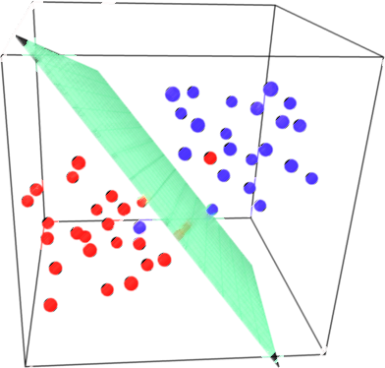

Lecture 16: Support Vector Machine (SVM) (Part I)
CSE445 Machine Learning
Dr. Jilan Samiuddin (JSA)
Assistant Professor
North South University

Slide 2
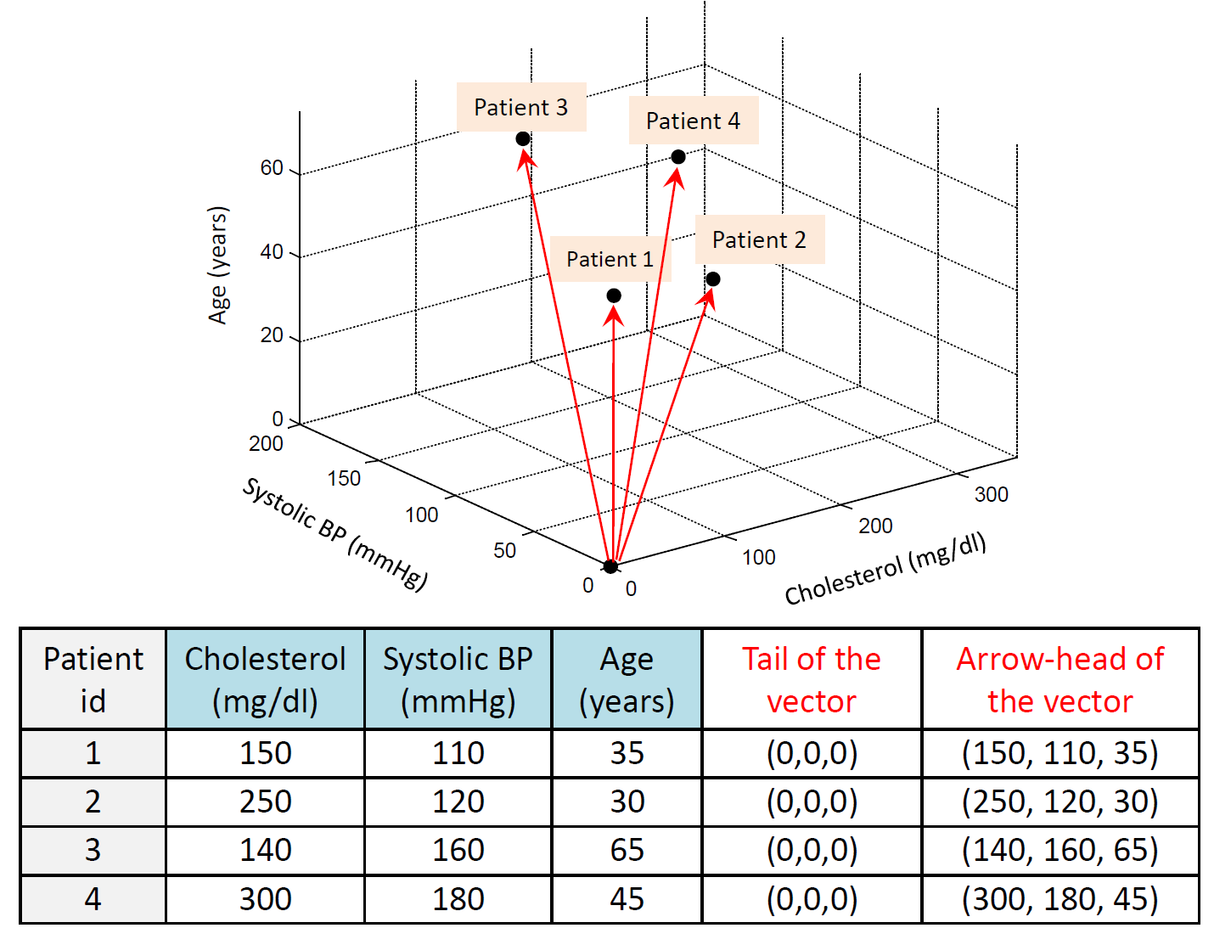
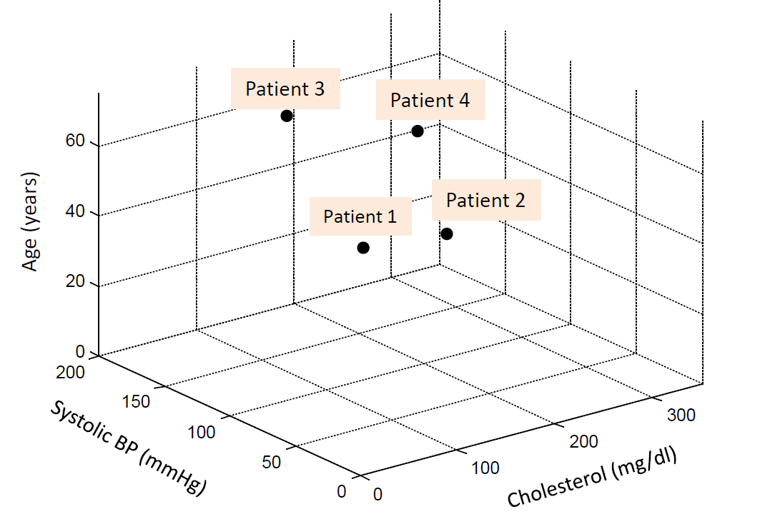
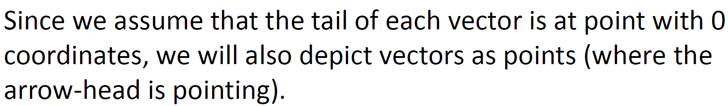
Representing samples as vectors (an example)

Slide 3
Optimization
The process of finding the “best” solution from all feasible options
Involves:
Objective Function: A mathematical expression to maximize or minimize (e.g., cost, profit, error)
Decision Variables: The elements you can control or adjust (e.g., selling price, number of units to manufacture)
Constraints: Equations or inequalities that restrict the decision variables (e.g., budget constraints, minimum salary)

Slide 4
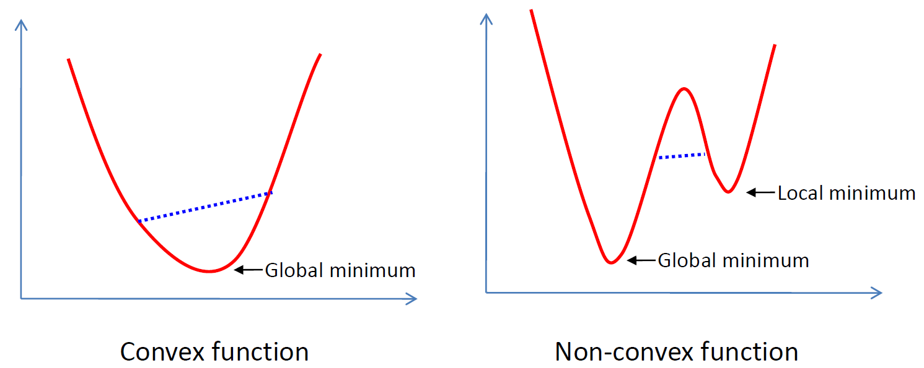
Basics of Optimization: Convex Function
A function is called convex if the function lies below the straight line segment connecting two points, for any two points in the interval.
Property: Any local minimum is a global minimum for a convex function!

Slide 5
Basics of Optimization: Quadratic Programming
Quadratic programming (QP) is a special optimization problem: the function to optimize (“objective”) is quadratic, subject to linear constraints
Convex QP problems have convex objective functions
These problems can be solved easily and efficiently because every local minimum is a global minimum

Slide 6
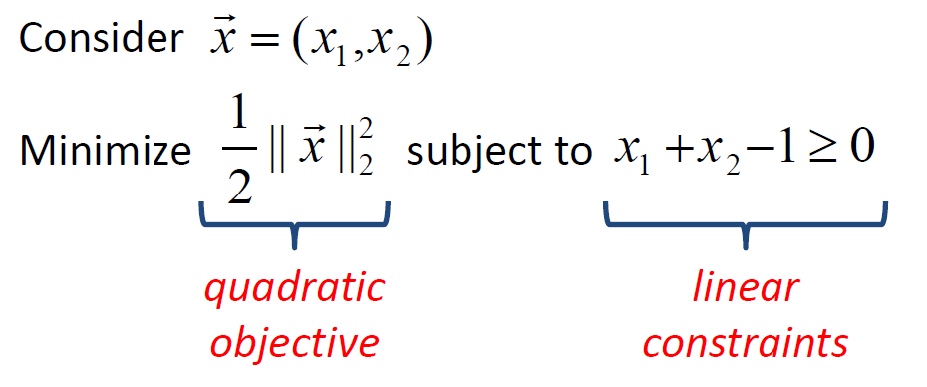
Example of QP Problem

Slide 7
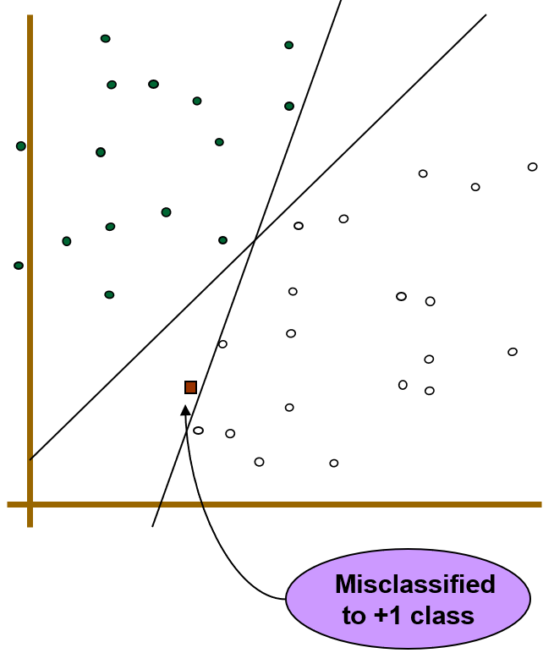
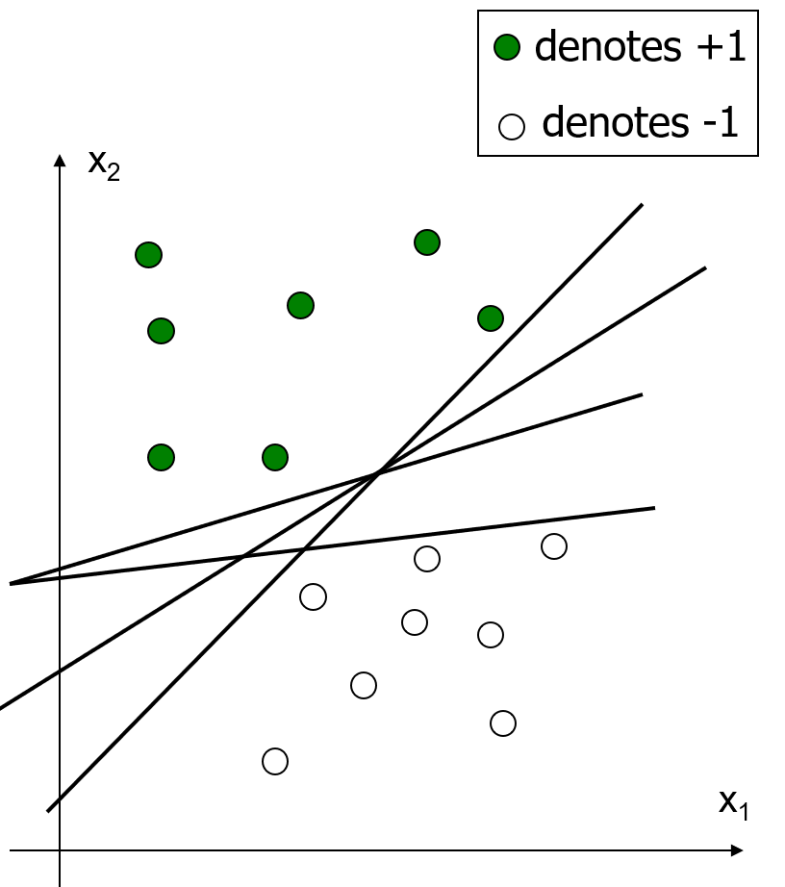
Perceptron…
Which one is the best among all the linear decision boundaries?
Perceptron does not provide a unique solution!

Slide 8
Support Vector Machine (SVM)

Slide 9
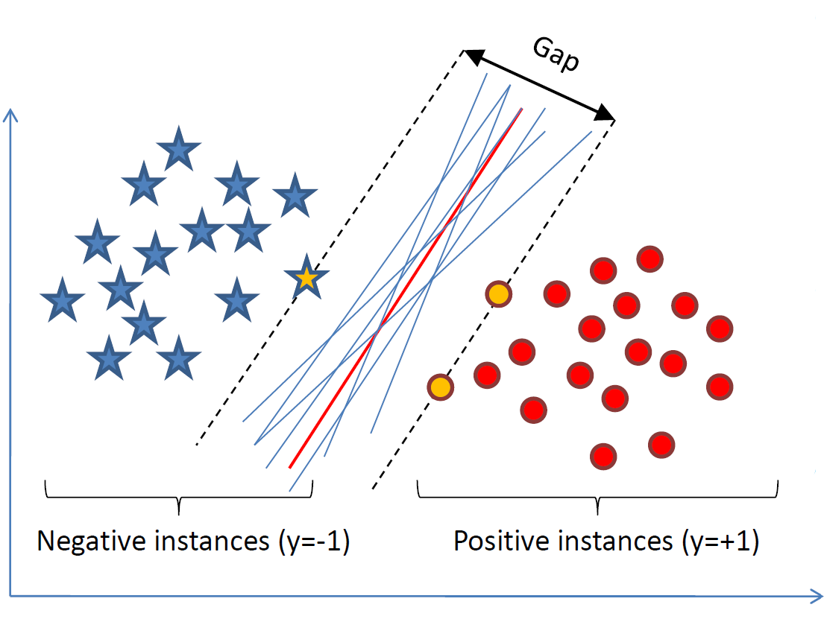
Case 1: Linearly Separable Data
We want to find a classifier (hyperplane) to separate negative instances from the positive ones
An infinite number of such hyperplanes exist
SVM finds the hyperplane that maximizes the gap between data points on the boundaries (“support vectors”)

Slide 10
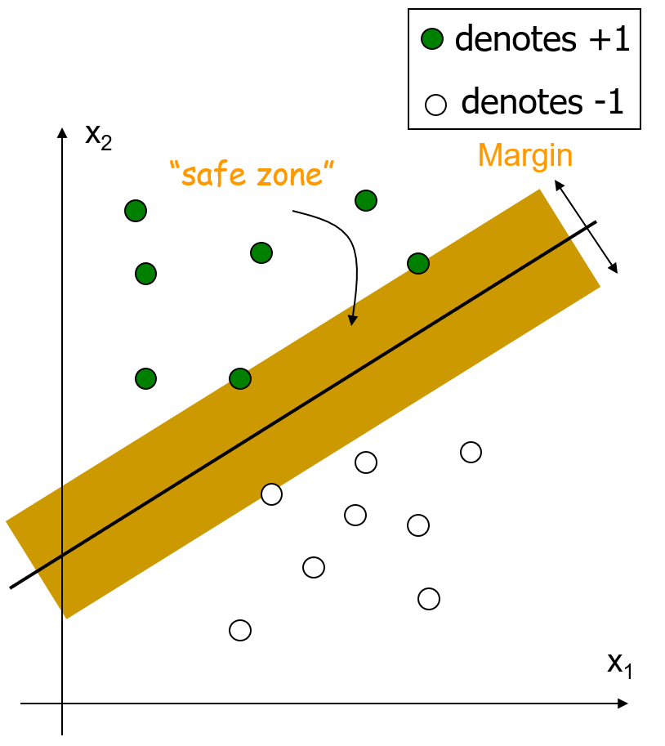
Linear SVM (Hard Margin)
Margin is defined as the width that the boundary could be increased by before hitting a data point in the learning set
The linear function (classifier) with the maximum margin is the best
Why best? Because it is robust to outliers and thus stronger generalization ability

Slide 11
Perceptron…
Only guarantees convergence (in a finite number of updates) if the data are linearly separable, but the resulting hyperplane can have arbitrarily small margin
Goal of perceptron: Find any hyperplane that correctly separates the data (it does not explicitly maximize margin)

Slide 12
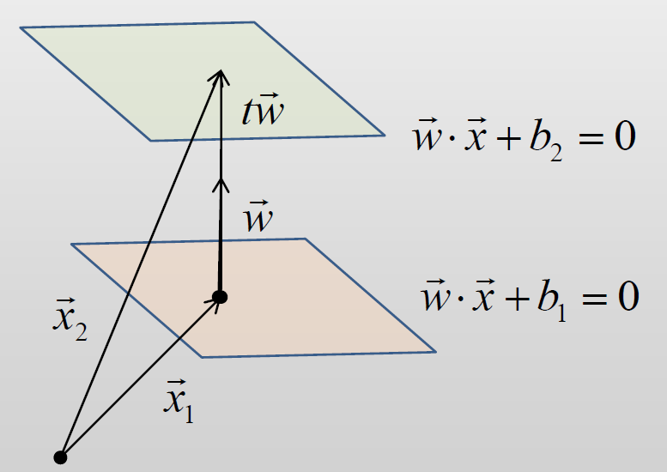
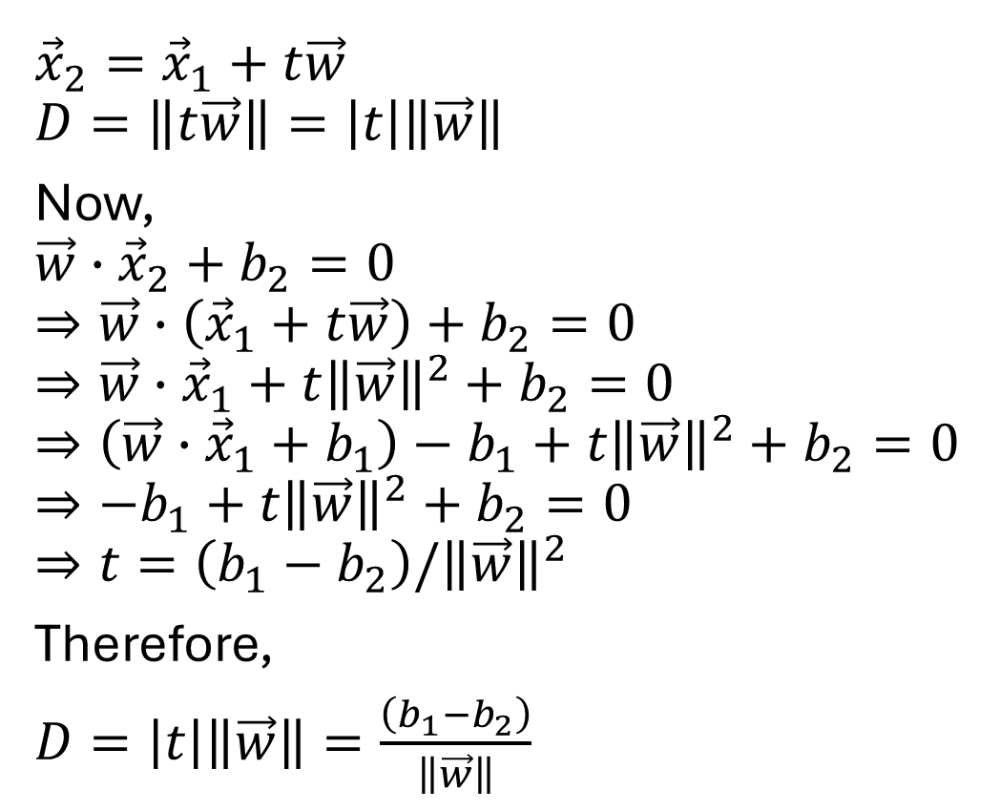
Distance between two parallel hyperplanes
$${\vec{x}}_{2}={\vec{x}}_{1}+t\vec{w}$$
$$D=\left\|t\vec{w}\right\|=\left|t\right|\left\|\vec{w}\right\|$$
Now,
$$\vec{w}∙{\vec{x}}_{2}+b_{2}=0$$
$$⇒\vec{w}∙\left({\vec{x}}_{1}+t\vec{w}\right)+b_{2}=0$$
$$⇒\vec{w}∙{\vec{x}}_{1}+t{\left\|\vec{w}\right\|}^{2}+b_{2}=0$$
$$⇒\left(\vec{w}∙{\vec{x}}_{1}+b_{1}\right)−b_{1}+t{\left\|\vec{w}\right\|}^{2}+b_{2}=0$$
$$⇒−b_{1}+t{\left\|\vec{w}\right\|}^{2}+b_{2}=0$$
$$⇒t=\left(b_{1}−b_{2}\right)/{\left\|\vec{w}\right\|}^{2}$$
Therefore,
$D=\left|t\right|\left\|\vec{w}\right\|=\frac{\left(b_{1}−b_{2}\right)}{\left\|\vec{w}\right\|}$

Slide 13
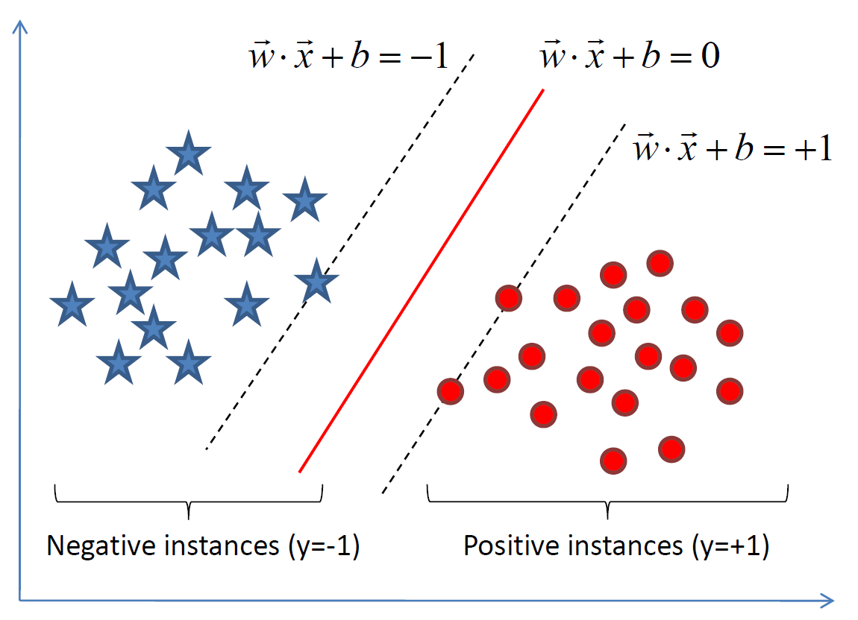
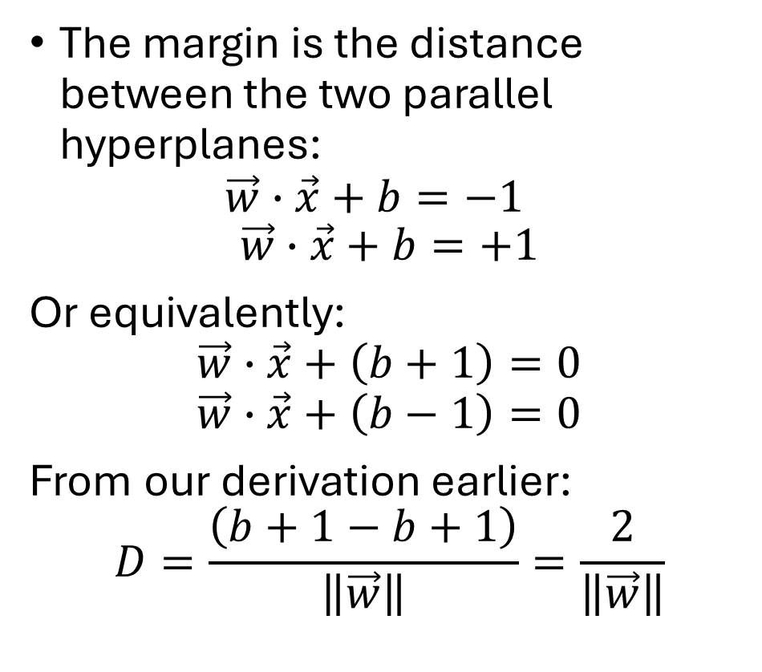
Problem formulation: Linear SVM
The margin is the distance between the two parallel hyperplanes: $\vec{w}∙\vec{x}+b=−1$
$$\vec{w}∙\vec{x}+b=+1$$
Or equivalently:
$$\vec{w}∙\vec{x}+\left(b+1\right)=0$$
$$\vec{w}∙\vec{x}+\left(b−1\right)=0$$
From our derivation earlier:
$$D=\frac{\left(b+1−b+1\right)}{\left\|\vec{w}\right\|}=\frac{2}{\left\|\vec{w}\right\|}$$

Slide 14
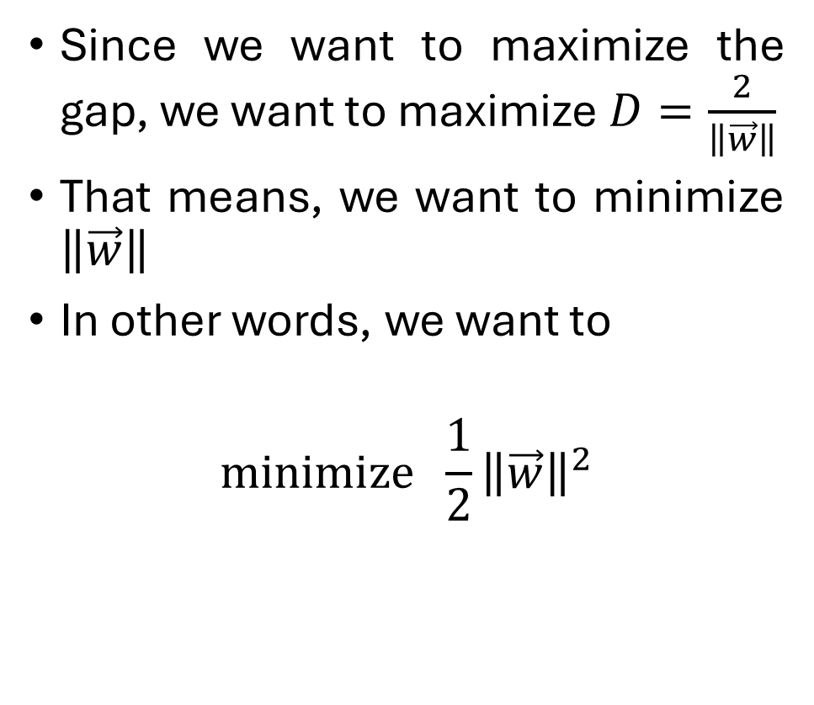

Problem formulation: Linear SVM (contd.)
Since we want to maximize the gap, we want to maximize $D=\frac{2}{\left\|\vec{w}\right\|}$
That means, we want to minimize $\left\|\vec{w}\right\|$
In other words, we want to
$$minimize \frac{1}{2}{\left\|\vec{w}\right\|}^{2}$$
$\frac{1}{2}$ is convenient for taking derivative later on

Slide 15
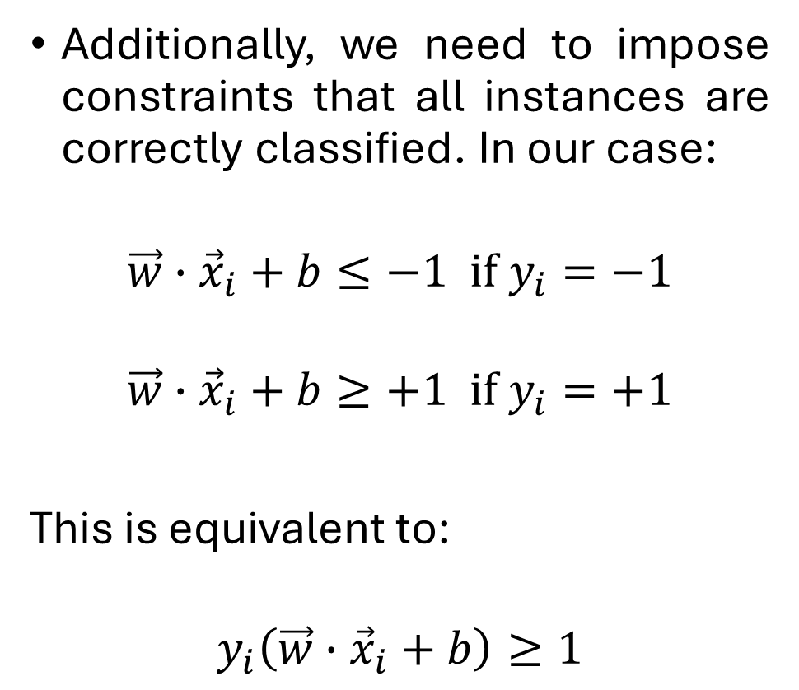
Problem formulation: Linear SVM (contd.)
Additionally, we need to impose constraints that all instances are correctly classified. In our case:
$$\vec{w}∙{\vec{x}}_{i}+b≤−1 if y_{i}=−1$$
$$\vec{w}∙{\vec{x}}_{i}+b≥+1 if y_{i}=+1$$
This is equivalent to:
$$y_{i}\left(\vec{w}∙{\vec{x}}_{i}+b\right)≥1$$

Slide 16
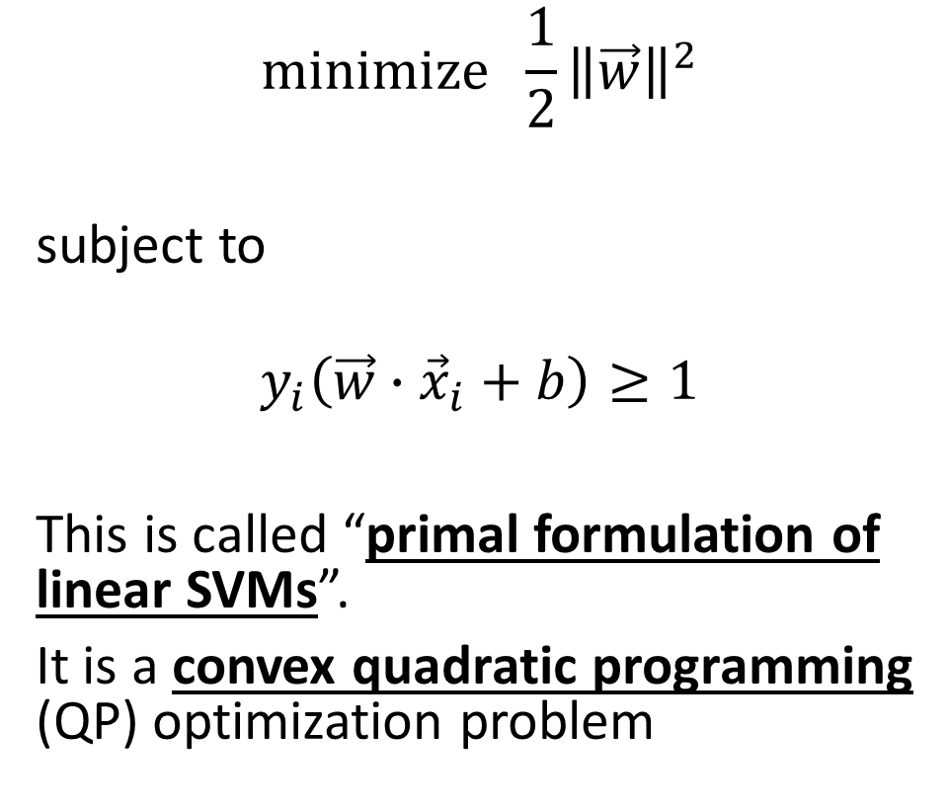
Linear SVM as an optimization problem
$$minimize \frac{1}{2}{\left\|\vec{w}\right\|}^{2}$$
subject to
$$y_{i}\left(\vec{w}∙{\vec{x}}_{i}+b\right)≥1$$
This is called “primal formulation of linear SVMs”.
It is a convex quadratic programming (QP) optimization problem
Objective
function
Constraint

Slide 17

The Dual Formulation of linear SVM
$$maximize \sum_{i=1}^{N}{α_{i}}−\frac{1}{2}\sum_{i=1}^{N}{\sum_{j=1}^{N}{α_{i}α_{j}y_{i}y_{j}\left({\vec{x}}_{i}.{\vec{x}}_{j}\right)}}$$
subject to
$$α_{i}≥0, and, \sum_{i=1}^{N}{α_{i}y_{i}}=0$$
The weight vector is defined in terms of $α_{i}$: $\vec{w}=\sum_{i=1}^{N}{α_{i}y_{i}{\vec{x}}_{i}}$
And the prediction becomes: $\hat{y}=sign\left(\sum_{i=1}^{N}{α_{i}y_{i}\left({\vec{x}}_{i}∙x\right)+b}\right)$
Objective
function
Constraint

Slide 18
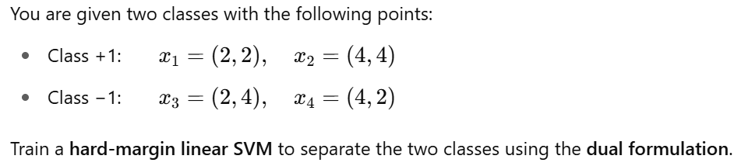
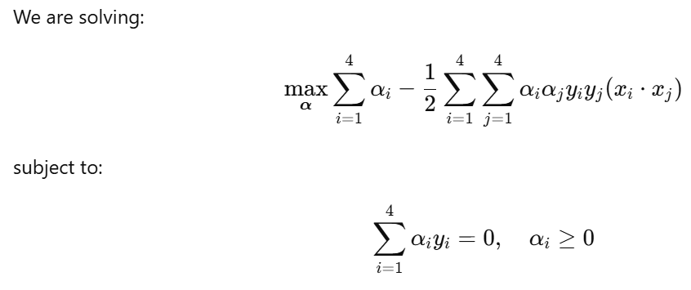
Mathematical Formulation
Problem statement:

Slide 19
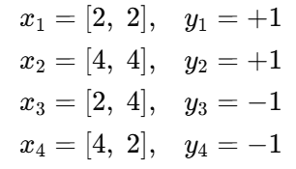
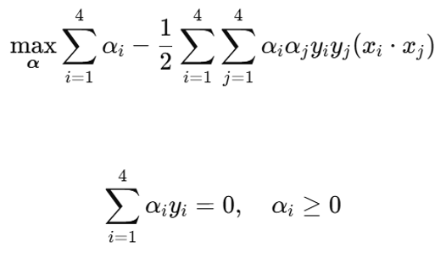
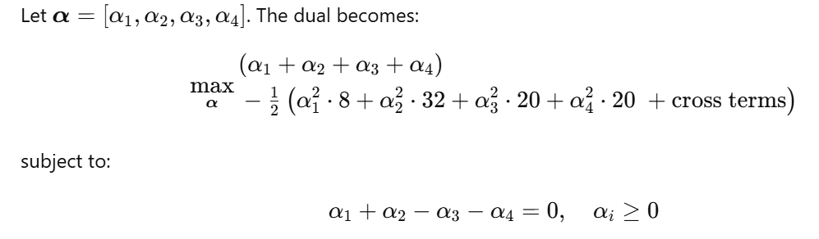
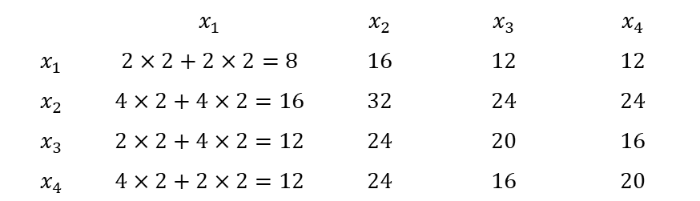
Mathematical Example (contd.)
Gram Matrix:
Rewrite the dual formulation:
 | $$x_{1}$$ | $$x_{2}$$ | $$x_{3}$$ | $$x_{4}$$
$$x_{1}$$ | $$2×2+2×2=8$$ | $$16$$ | $$12$$ | $$12$$
$$x_{2}$$ | $$4×2+4×2=16$$ | $$32$$ | $$24$$ | $$24$$
$$x_{3}$$ | $$2×2+4×2=12$$ | $$24$$ | $$20$$ | $$16$$
$$x_{4}$$ | $$4×2+2×2=12$$ | $$24$$ | $$16$$ | $$20$$

Slide 20
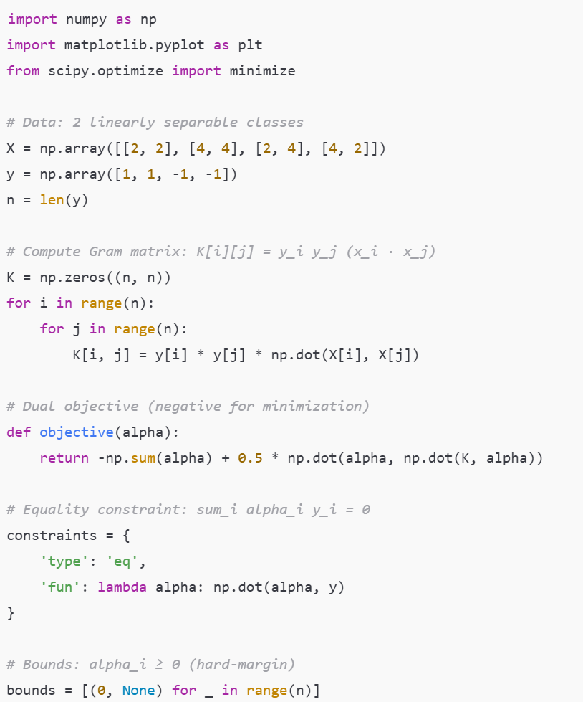
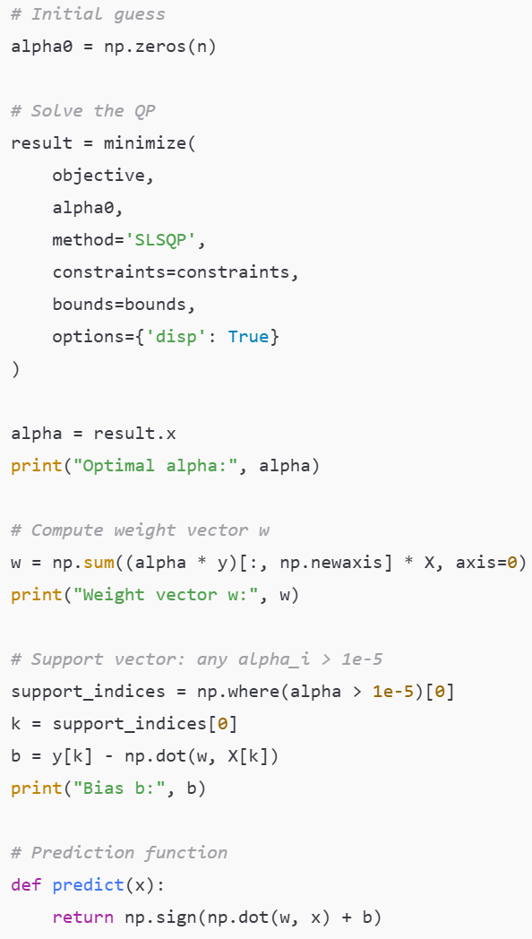
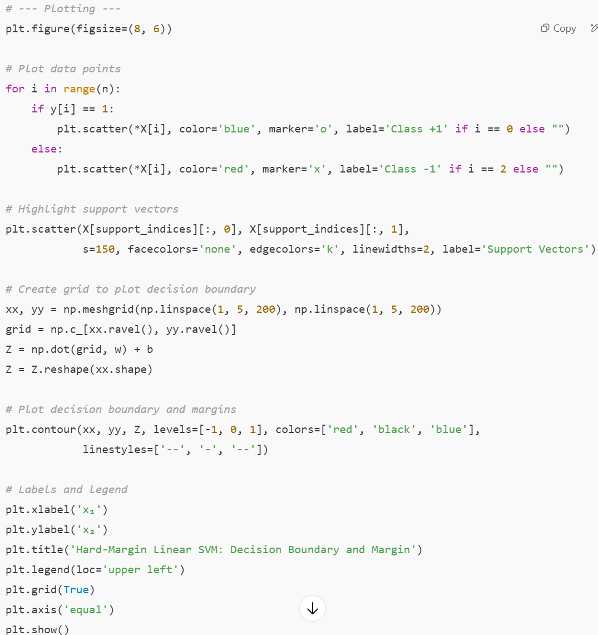
Python Code Example
-1
+1

Slide 21
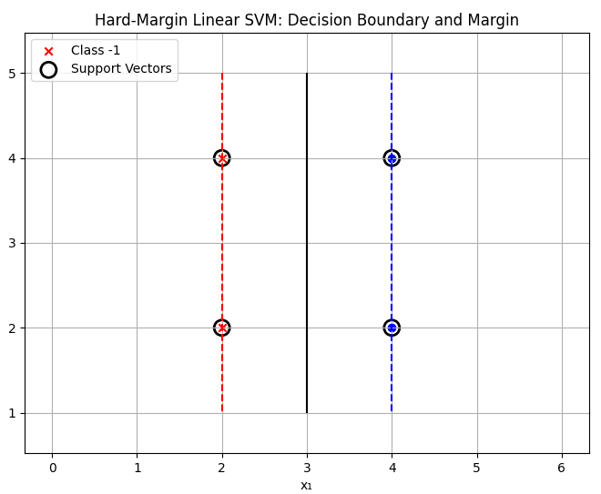
Python Code Example
Optimal alpha: [0.25 0.25 0.25 0.25]
Optimal weight vector w: [0.99 0]
Optimal bias b: -2.99

Slide 22
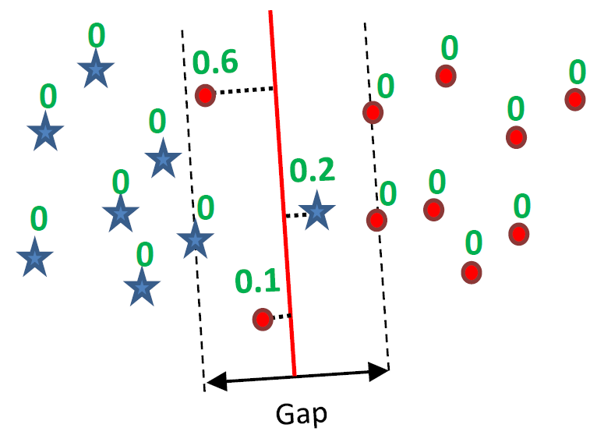
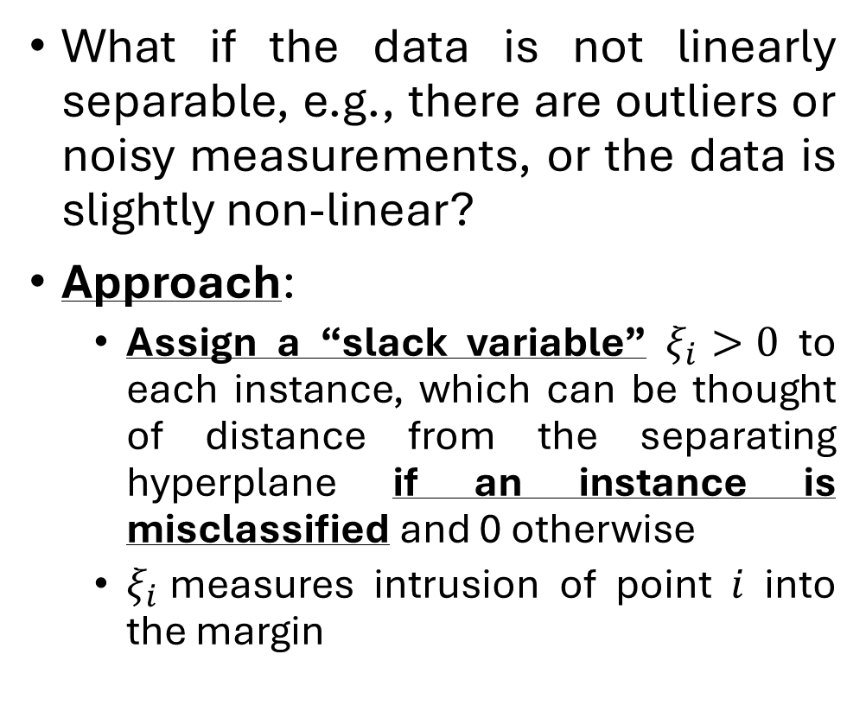
Case 2: Not Linearly Separable Data – Soft-margin Linear SVM
What if the data is not linearly separable, e.g., there are outliers or noisy measurements, or the data is slightly non-linear?
Approach:
Assign a “slack variable” $ξ_{i}>0$ to each instance, which can be thought of distance from the separating hyperplane if an instance is misclassified and 0 otherwise
$ξ_{i}$measures intrusion of point $i$ into the margin

Slide 23

Linear SVM (Soft-margin): Optimization
$$minimize \frac{1}{2}{\left\|\vec{w}\right\|}^{2}+C\sum_{i=1}^{N}{ξ_{i}}$$
subject to $y_{i}\left(\vec{w}∙{\vec{x}}_{i}+b\right)≥1−ξ_{i}$
Dual formulation:
$maximize \sum_{i=1}^{N}{α_{i}}−\frac{1}{2}\sum_{i=1}^{N}{\sum_{j=1}^{N}{α_{i}α_{j}y_{i}y_{j}\left({\vec{x}}_{i}.{\vec{x}}_{j}\right)}}$
subject to $0≤α_{i}≤C$ and $\sum_{i=1}^{N}{α_{i}y_{i}}=0$

Slide 24
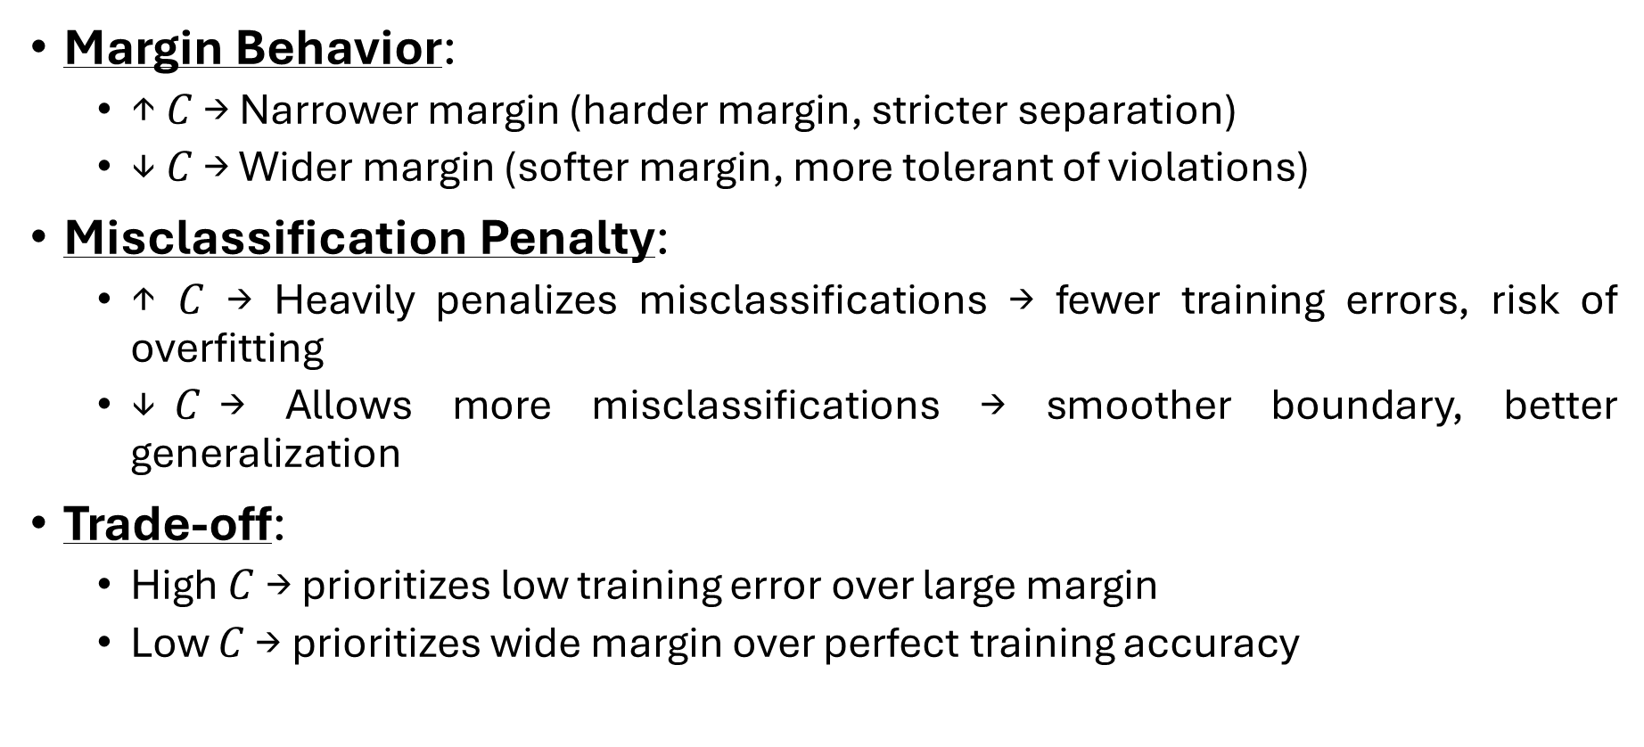
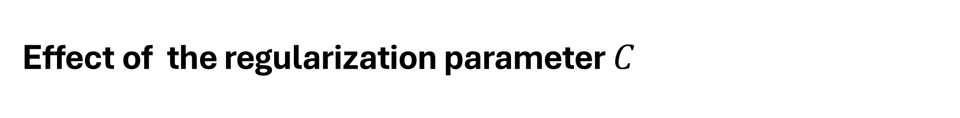
Effect of the regularization parameter $C$
Margin Behavior:
↑ $C$ → Narrower margin (harder margin, stricter separation)
↓ $C$ → Wider margin (softer margin, more tolerant of violations)
Misclassification Penalty:
↑ $C$ → Heavily penalizes misclassifications → fewer training errors, risk of overfitting
↓$C$→ Allows more misclassifications → smoother boundary, better generalization
Trade-off:
High $C$ → prioritizes low training error over large margin
Low $C$ → prioritizes wide margin over perfect training accuracy

Slide 25
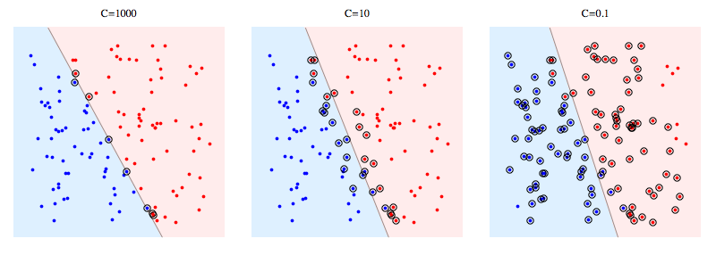
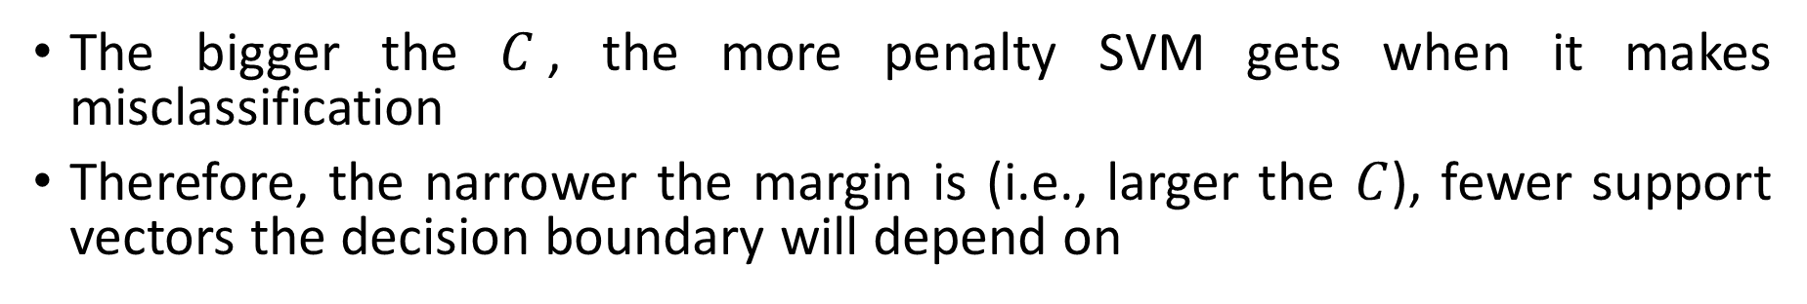
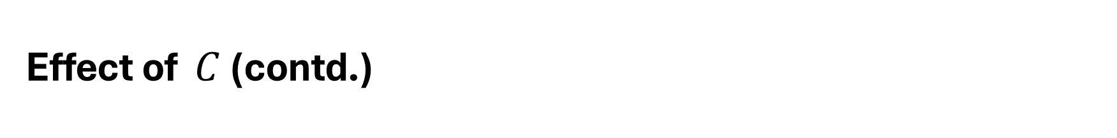
Effect of $C$ (contd.)
The bigger the $C$, the more penalty SVM gets when it makes misclassification
Therefore, the narrower the margin is (i.e., larger the $C$), fewer support vectors the decision boundary will depend on

